Slide 1
Computer Architecture

Slide 2
Objectives
Computer
Input and Output Devices
Motherboard
Machine cycle
Memory vs. Storage

Slide 3
Computer

Slide 4
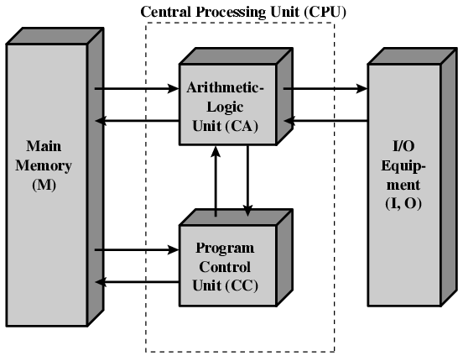

Slide 5
Computer
programmable, electronic device that accepts data, performs operations, presents the results, and can store the data or results
Input—entering data into the computer
Processing—performing operations on the data
Output—presenting the results
Storage—saving data, programs, or output for future use

Slide 6
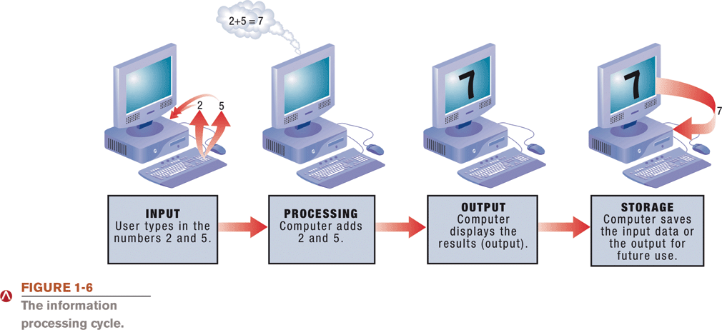

Slide 7
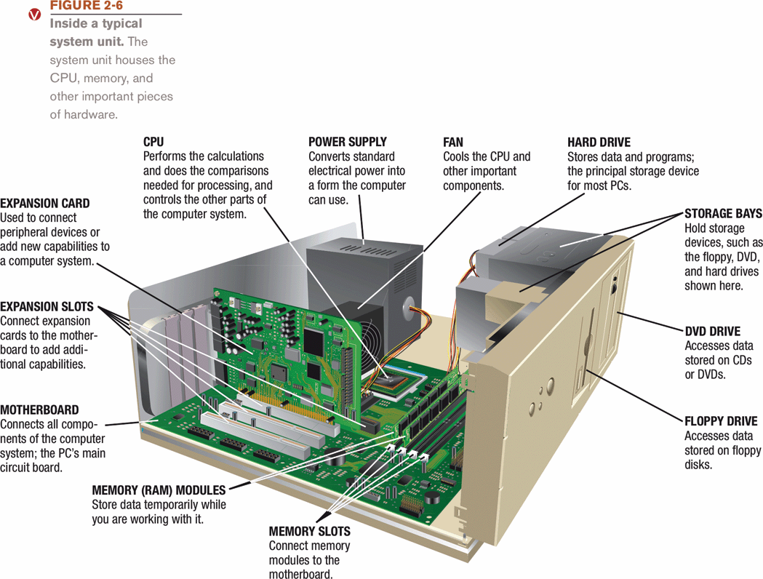
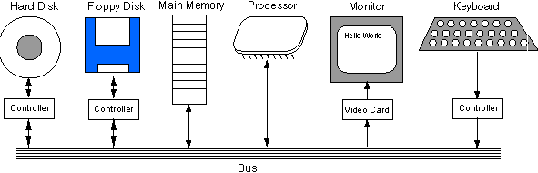
المكونات الداخلية للحاسب

Slide 8
Input and Output Devices

Slide 9
Input Devices
Keyboard
Mouse
Trackball, touchpad, mouse stick
Microphone
Scanner
Bar code reader
Card reader

Slide 10
Output Devices
Monitor
Printer
Speaker
Plotter

Slide 11
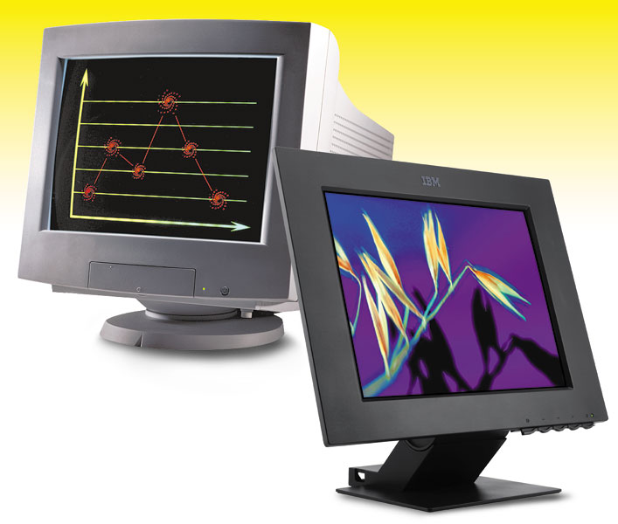
Monitor
A monitor is a peripheral device which displays computer output on a screen.
Screen output is referred to as a soft copy.

Slide 12
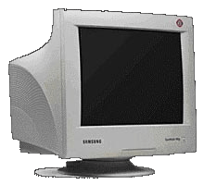
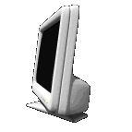
Types of Monitors
CRT
Cathode-ray tube (CRT)– Resemble televisions; use picture tube technology; inexpensive, but they take up desk space and use a lot of energy.
Liquid Crystal Display (LCD or flat-panel)– Cells sandwiched between two transparent layers form images; used for notebook computers, PDAs, cellular phones, and personal computers; expensive, and they take up less desk space and use less energy than CRT monitors.
LCD

Slide 13
Monitor Specifications
Screen size– The diagonal measurement of the screen surface in inches (15, 17, 19, 21).
Resolution– The sharpness of the images on the screen determined by the number of horizontal and vertical pixels that the screen can display (800x600, 1024x768, 1600x1200).
Dot pitch– The distance between each pixel on the screen measured in millimeters (.22mm, .25mm, .28mm).

Slide 14

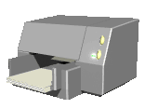
Printers
A printer is a peripheral device that produces a physical copy or hard copy of the computer’s output.
Two basic types:
  Impact printer
  Nonimpact printer

Slide 15
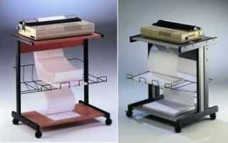

Impact Printer
Impact printer
Dot-matrix
An impact printer is a printer that has a print head that contacts the paper to produce a character.
It uses ink ribbon.
It is noisy, produces Near-letter quality printouts, and is not commonly used today.
Dot-matrix– Pins are used to make characters.

Slide 16

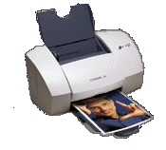
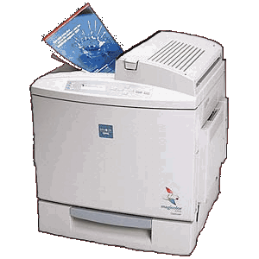
Nonimpact Printer
Inkjet
Laser
Two types of nonimpact printers:
  Inkjet printer– Also called bubble-jet; makes characters by inserting dots of ink onto paper;
  Laser printer works like a copier; quality determined by dots per inch (dpi)

Slide 17
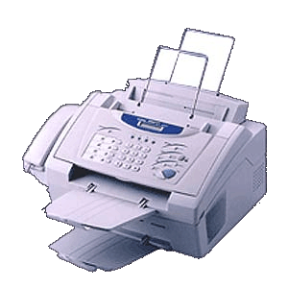
Multifunction Printer
A multifunction printer combines the functions of a nonimpact printer, scanner, fax machine, and copier in one unit.

Slide 18
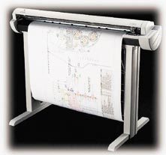
Plotter
A plotter is a printer that uses a pen that moves over a large revolving sheet of paper.
It is used in engineering and map making.

Slide 19
Motherboard

Slide 20
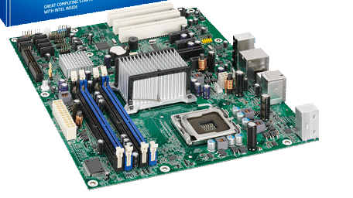

Slide 21
Motherboard
  It holds and allows communication between many of the electronic components of a system, such as the central processing unit (CPU) and memory, and provides connectors for other peripherals.
  It is on the size of A4 paper, its color is green or gold. On which we can distinguish the following components:

Slide 22
Motherboard
-RAM
-Expansion Slots
-Expansion Cards
-Processor, on which a fan or a heat sink is mounted.
-Battery
-Power supply to convert the 200v ac to 3.3 v dc.
-Clock, which generates series of pulses per second
-Chip Sets
-ROM
-Connectors

Slide 23
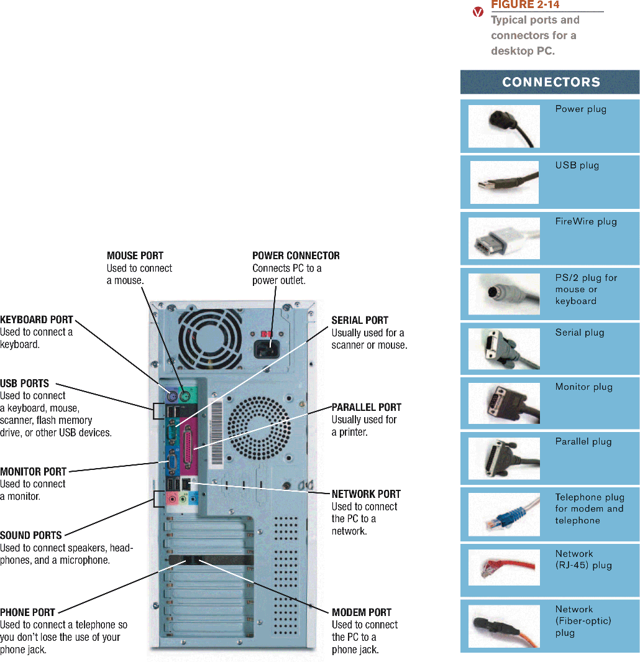

Slide 24
Machine cycle

Slide 25
كيف تنفذ وحدة التشغيل الأمر
Four steps performed for each instruction
  Machine cycle: the amount of time needed to execute an instruction
  Personal computers execute in less than one millionth of a second
  Supercomputers execute in less than one trillionth of a second
Each CPU has its own instruction set
  those instructions that CPU can understand and execute

Slide 26
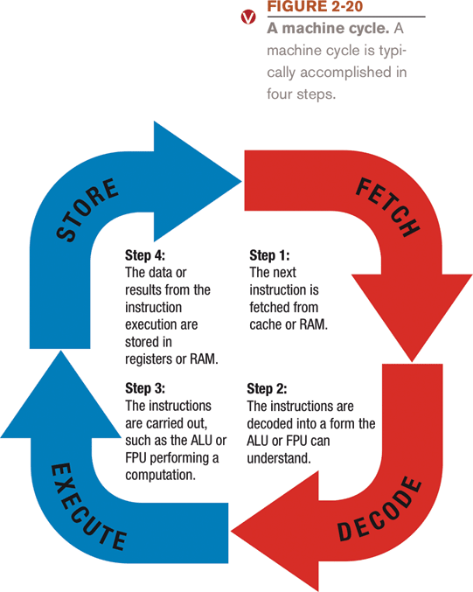

Slide 27
Memory vs. Storage

Slide 28

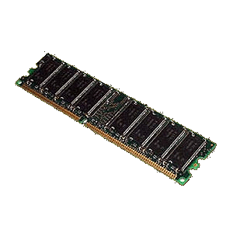
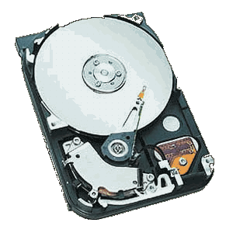
Memory vs. Storage
Hard Drive
RAM Memory
Storage, also known as mass media or auxiliary storage, refers to the various media on which a computer system can store data.
Storage devices hold programs and data in units called files.
Files are stored in directories or folders.
Memory is a temporary workplace where the computer transfers the contents of a file while it is being used.

Slide 29
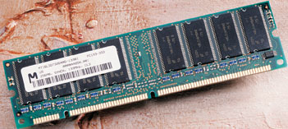

Slide 30
Why is storage necessary?
Storage:
Retains data when the computer is turned off.
Is cheaper than memory.
Plays an important role during startup.
Plays an input role when starting applications.
Is needed for output.
Devices can hold a large amount of data.

Slide 31
Storage Devices
Storage devices are:
Hardware that is capable of retaining data when the electricity is turned off.
Able to read (retrieve) data from a storage medium (disk/tape).
Able to write (record) data to a storage medium.
NEXT
SLIDE

Slide 32
Types of Storage Technologies
Sequential– Hardware that reads and writes data in a serial (one after the other) fashion.
Random-Access– Hardware that reads and writes data without going through a sequence of locations.
Magnetic– Hardware that uses disks or tapes that are coated with magnetic material.
Optical– Hardware that uses laser beams to read data from plastic disks.
Solid State– Devices that use nonvolatile memory chips to read and write data.

Slide 33
The Storage Hierarchy
Storage hierarchy consists of three levels. They are:
Online storage– Also called primary storage, it is made up of the storage devices that are actively available to the computer system. User action is not required.
Near-online storage– Also called secondary storage, it is not readily available to the computer system. The user performs an action, such as inserting a disk, to make it available.
Offline storage– Also called tertiary storage or archival storage, it is not readily available to the computer system. Devices such as tape backup units store data for archival purposes.

Slide 34
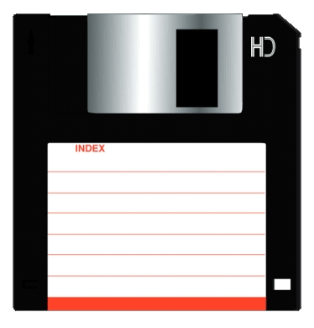
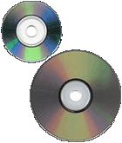
Capacity and Speed of Storage Devices
Floppy Disk
Hard Drive
CD ROM / DVD
Capacity– 720 KB to 1.44 MB
Access Time– 100ms
Capacity– Up to 1 TB
Access Time– 6 to 12ms
Capacity– CD-ROM 650 MB; DVD 17 GB
Access Time– 80 to 800ms
A storage device’s performance is measured by:
Capacity– The number of bytes of data that a device can hold.
Access Time– The amount of time, in milliseconds (ms), it takes for the device to begin reading data.

Slide 35
Disks and Disk Drives
A disk or diskette is a portable storage medium.
Disks are circular plastic disks coated with a magnetically sensitive film.
Disks work with a disk drive.
High-density floppy disks
Floppy disks store 1.44 MB of data.
SuperDisk and High FD disks store up to 250 MB of data and are downwardly compatible with floppy disks.

Slide 36
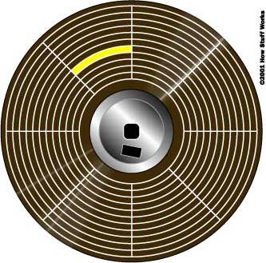
Disk Organization
Track
Sector
Cluster
A disk is formatted–that is, it is divided into tracks and sectors and a file allocation table (FAT) is created.
  Track– circular band
  Sector– pie shaped section
  Cluster– two or more adjacent sectors
  FAT– keeps track of specific locations of files

Slide 37
How Hard Disks Work
Platter
Read/Write head
Hard disks are a high-speed, high-capacity storage devices.
They contain metal disks called platters.
They contain two or more stacked platters with read/write heads for each side.
Hard disks can be divided into partitions to enable computers to work with more than one operating system.

Slide 38
Factors Affecting a Hard Disk’s Performance
Seek time or positioning performance– How quickly the read/write head positions itself and begins transferring information. It is measured in milliseconds (ms).
Spindle speed or transfer performance– How quickly the drive transfers data. It is measured in rotations per minute (RPM).
Latency– The time it takes for the spinning platter to bring the desired data to the read/write head. It is measured in milliseconds (ms).

Slide 39
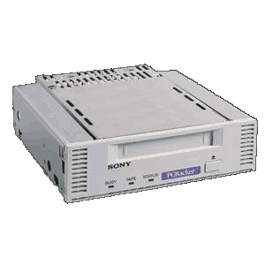
Magnetic Tape
Tape Backup Unit
Magnetic tape backup units store large amounts of data that are not used frequently.
They use a cassette-type reel-to-reel plastic tape.

Slide 40
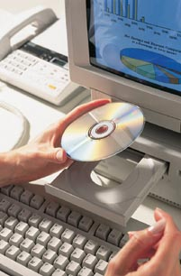
CD-ROM Disks and Drives
CD-ROM stands for Compact Disk-Read Only Memory.
They are capable of storing 650 MB of data.
They are used for storing operating systems, large application programs, and multimedia programs.

Slide 41
CD-R and CD-RW Disks and Recorders
CD-R
Disks that can be read and written to.
Disks can only be written to “once”.
Drives that are capable of reading and writing data are needed.
CD-RW
Disks that can be read and written to.
Disks are erasable.
Disks can be written to many times.
Drives that are capable of reading, writing and erasing data are needed.

Slide 42
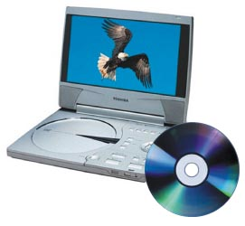
DVD-ROM Disks and Drives
DVD stands for Digital Video Disk.
They use technology similar to CD-ROM.
They are capable of storing up to 17GB of data.
Their data transfer rate is comparable to that of hard disk drives.
DVD-RAM– Has the ability to read/write data.

